Slide 1
The Mobile Underground Activities in China
Lion Gu, Trend Micro
RUXCON 2014
11/10/2014

Slide 2
About Lion
Threat researcher of Trend Micro
  Malware analysis
  Mobile security
  Underground activities
  …
11+ years as security professionals
First time to RuxCon
  Thanks a lot for invitation☺
First time as speaker
  Feel nervous☺

Slide 3
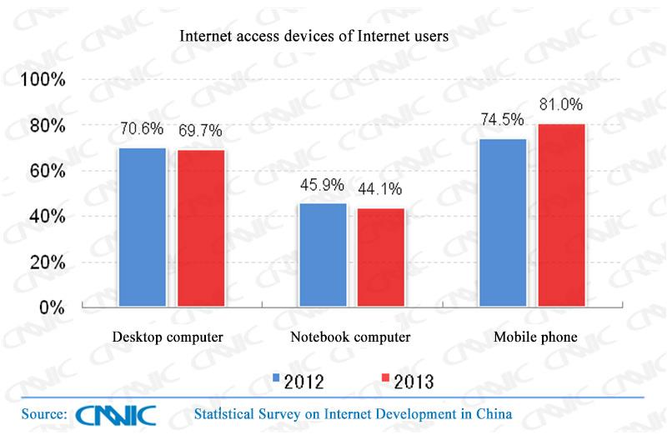
Mobile Phone - Major Internet Access Device in China

Slide 4
Mobile Phone – Hot Target of Bad Guys
Large amount of users
A lot of privacy
  Contacts
  Photos
  Messages
Phone charges
Can connect to Internet

Slide 5

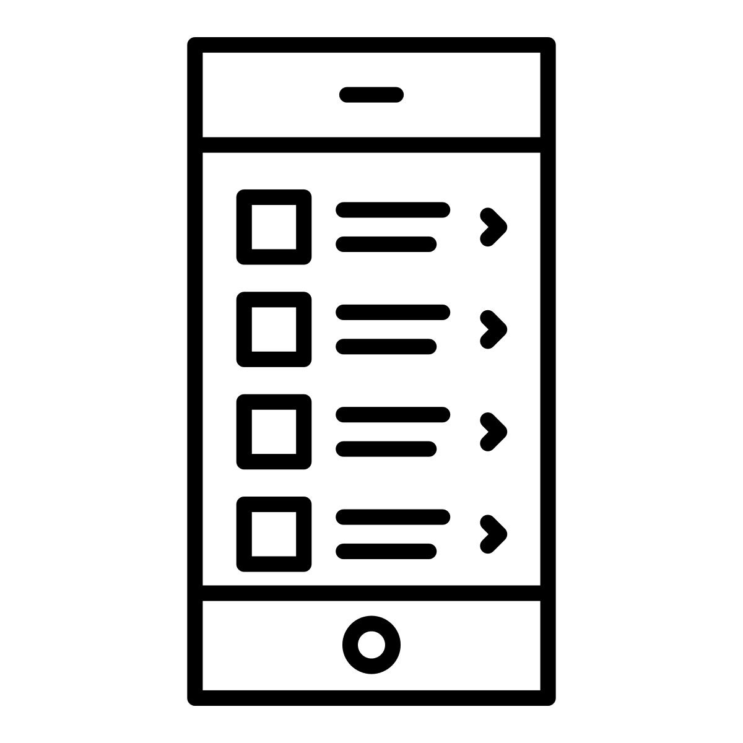

Attack Vectors for Mobile Phone
APP
Message
Call

Slide 6
Vector
Purpose
Product/Service
Privacy
SMS Forwarder
APP
Unapproved Charges
Premium Service Number
Notes:
Goal
Target

Slide 7
SMS Forwarder
Malicious app running in Android phone
Forward victim’s SMS from given sender, like
  Banks
  Online payment services
Target for certain SMS, like
  Registration
  Password resetting

Slide 9

Product/Service | Price
Source code of SMS forwarder | RMB 3,000 (AUD 557)

Slide 10
Premium Service Number
Unique phone number for subscription of a premium SMS
Common premium SMS services:
  Weather SMS
  News SMS
Subscription need confirmation SMS sent by users manually

Slide 11
Abuse of Premium SMS
Rogue Premium SMS operators
  Apply service permission from mobile carriers
  Rent premium service numbers to anyone
Rogue Android developers
  Buy and exploit premium service numbers for unapproved charges
  Subscription and confirmation SMS are sent by apps automatically
  Relevant SMS are deleted for stealthy

Slide 12
Products/Services | Prices
6-digit premium service number | RMB 220,000 (AUD 40,855) per year
7-digit premium service number | RMB 100,000 (AUD 18,570) per year
8-digit premium service number | RMB 50,000 (AUD 9,285) per year
9-digit premium service number | RMB 15,000 (AUD 2,785) per year

Slide 13
Vector
Purpose
Product/Service
Spam
SMS Server
Message
GSM Modem Pool
Phishing
iMessage Spamming
Notes:
Goal
Target

Slide 14
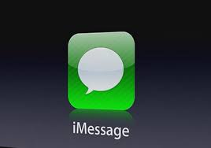
iMessage
iMessage is Apple’s instant-messaging (IM) service
Run on both iOS and OS X
Support sending various messages via Internet without charges
  Text messages
  Group messages
  Audio messages
  Video messages

Slide 15
Spamming in iMessage

Slide 16
Spamming Targets iPhone Users
Phone numbers of iPhone can be used for iMessage accounts
Can probe phone numbers to look for accounts
  Send probe message
  Check send status from iMessage server

Slide 17
iMessage Spam Work

Slide 18
Products/Services | Prices
1,000 text messages in iMessage | RMB 100 (AUD 19)
1,000 multimedia messages in iMessage | RMB 500 (AUD 93)
“iMessage Spam Work” software | RMB 30,000 (AUD 5,571)

Slide 19
SMS Server
A low-cost piece of radio frequency (RF) hardware
Emit software-defined radio (SDR) signals in GSM frequency ranges
Also known as ‘FAKE BASE STATION (伪基站)’ in China

Slide 20
SMS Server Box

Slide 21







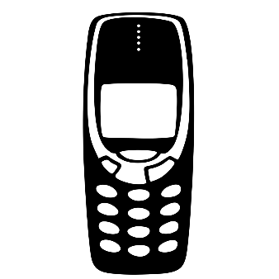
SMS Server
Base Station of Carrier
GSM Phone
Notes:
Announce itself as base station by emitting high power radio
Force all nearby GSM mobile phones to connect to it
Push spam SMS to connected phones

Slide 22
Specification of SMS Server
Frequency range of signal
  Uplink: 885‒915MHz
  Downlink: 930‒960MHz
Working range: 200 ~ 2,000 meters
Pushing SMS: 300 msg/min

Slide 23
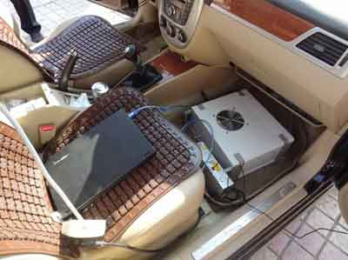
Impact of SMS Server
Serve for fraud attack
  Sender number in such SMS can be assigned to public service number, like bank’s number
Interrupt communication to legal carriers
Hard to trace and take down

Slide 24
Products/Service | Price
SMS server | RMB 45,000 (AUD 8,357)

Slide 25
GSM Modem Pool for Spam SMS
A device used for sending SMS
It integrates a number of GSM modules
  Each module operates like a normal mobile phone does
A GSM modem pool with 16 modules can send 9,600 SMS messages in one hour

Slide 26
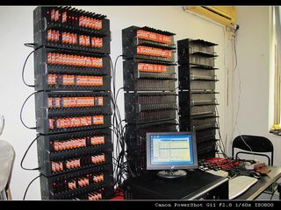

Slide 27
Products/Service | Price
GSM modem pool with 16 GSM modules | RMB 2,600 (AUD 483)

Slide 28
Vector
Purpose
Product/Service
Scam
Call
Phone Number Scanning
Promoting
Notes:
Goal
Target

Slide 29
Where Are Targets of Scam?
Huge amount of phone numbers offered by telecom carriers
But, 40% phone numbers are not in service
  Power off, unreachable,…
Spammers and scammers need ACTIVE phone numbers

Slide 30
Phone Number Scanning
Scanning service
  Offers ACTIVE phone numbers
  Service owner probes large amount of phone numbers regularly
  On demand scanning is also available
Scanning tools
  Offers device and software
  Fulfill demand of custom scanning

Slide 31
Scanning Software - Sanwangtong

Slide 32
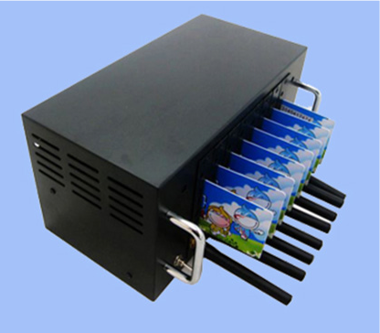
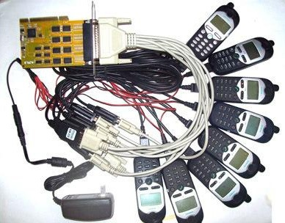
Scanning Device
GSM Modem Pool with 8 GSM Modules and SIM Cards
8 GSM Phones with 1 PCI Serial Card

Slide 33
Products/Service | Price
3,000,000 queries for active phone numbers | RMB 1,000 (AUD 186)
“Sanwangtong” phone number scanning software | RMB 230 (AUD 43)
8 GSM phones and 1 PCI serial card | RMB 1,100 (AUD 204)

Slide 34
Experience of Monitoring Underground Activities
Mobile businesses are hot in underground
  Many posts and participants in underground forums, instant messaging groups
Selling messages are more than buying messages
Use Alipay as payment method
  Alipay is an online payment service in China
Use Tencent QQ as communication tool
Most participants work at night
  Peak time: 19:00 ~ 22:00
A lot of cheaters
  Be careful☺

Slide 35
Thank You ☺

